Slide 1
Retail Sales Use Case Generating retail sales data from scratch, using medallion architecture to store and model the data in MS Fabric Data Lakehouse and implementing Exploratory Data Analysis to get data insights and predict Sales for the next Quarter
Team Fab-Predict

Slide 2
Team Fab-Predict
Subham Sanoriya
Shaik Mussarathulla
Saranya K
Zeba Khan

Slide 3

OBJECTIVE:
To develop a predictive analytics model that leverages historical sales data, market trends, and customer behavior to accurately forecast future sales, enabling proactive business decisions and strategic planning.

Slide 4
Technical Challenges Faced:
The data is limited so multiple real time scenarios were left unexplored.
Model Complexity: Choosing a model that balances complexity and performance without overfitting or underfitting the data.
Interaction Effects: Understanding how different features interact and affect sales together.

Slide 5
Comparative Analysis: Unique Value Proposition of Our Solution:
Domain-agnostic solution.
A base level analysis approach that can be applied to any sales data using EDA and experimenting across all segments within data
With the advantage of using MS Fabric, the data model can be modifed and updated at any layer (bronze or gold) and we can run Python scripts/Power BI Semantic Model and SQL Queries all in one space using that data model

Slide 6
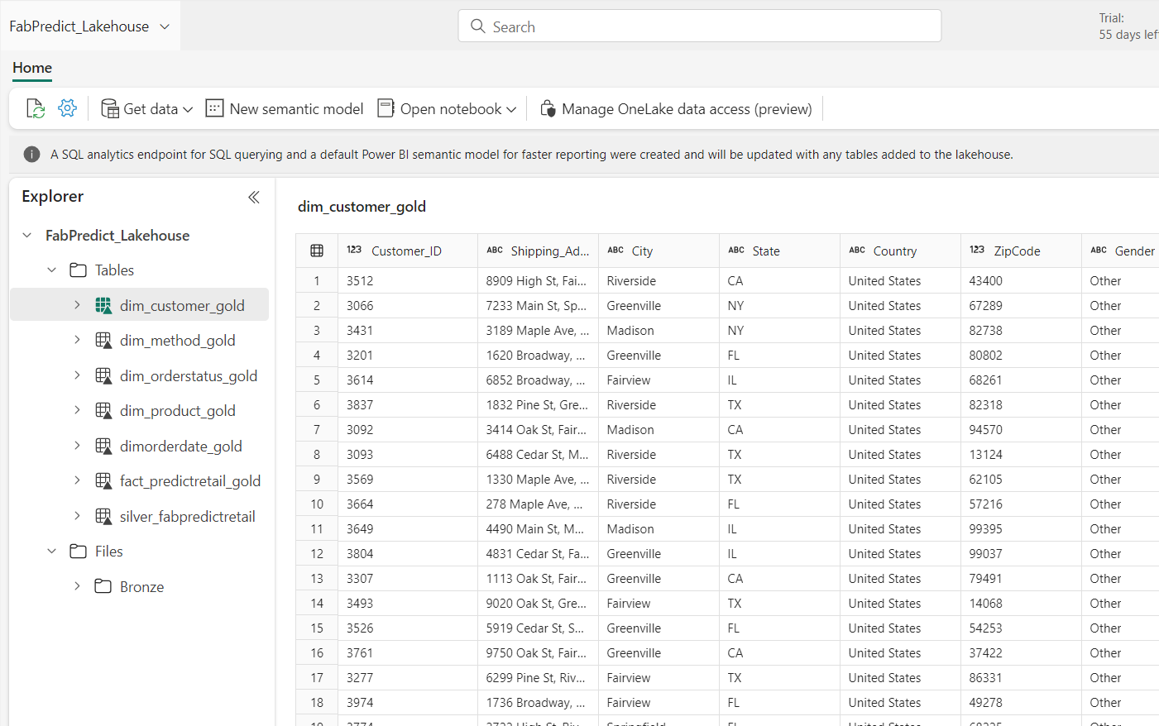
Technical Architecture
A view of of the medallion structure created on Fabric Lakehouse with random retail sales data generated using python script

Slide 7
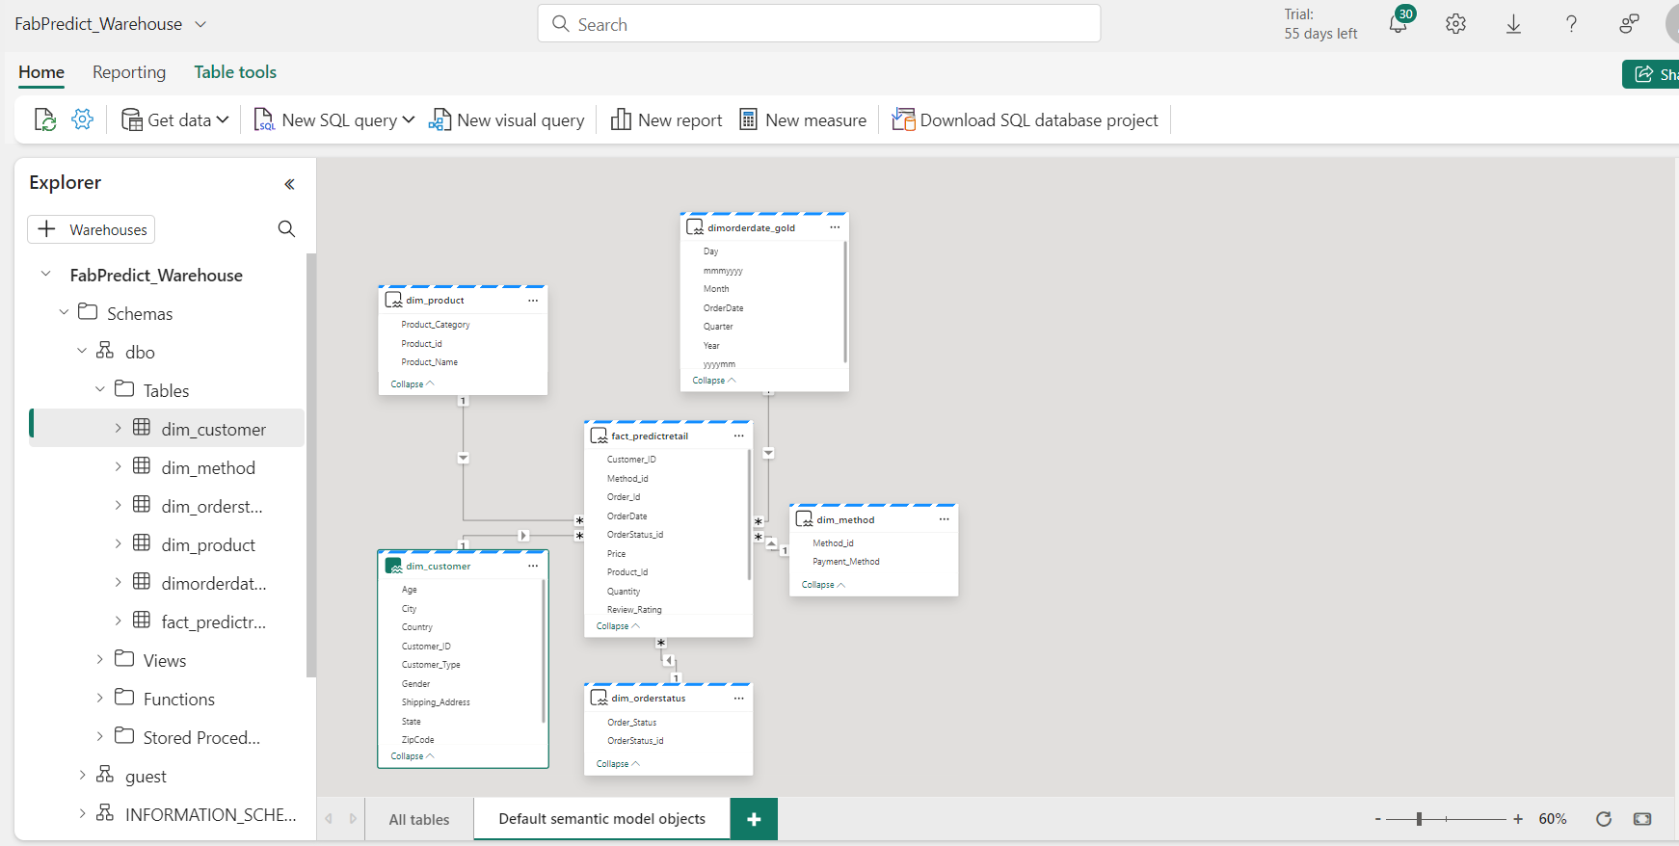
Power BI Data Model created with fact and dimension tables.

Slide 8
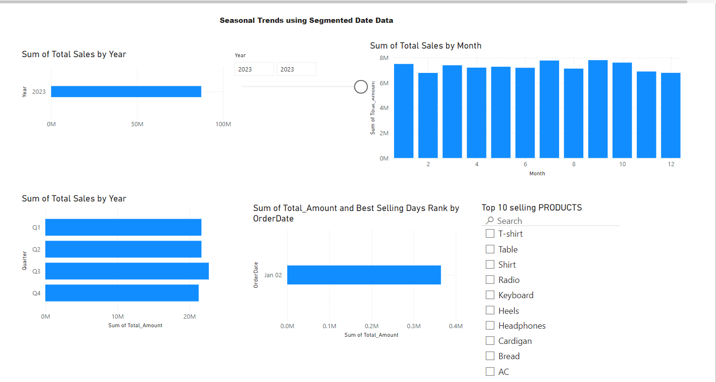
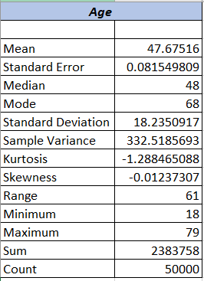
Exploratory Data Analysis Done using Power BI/Excel, SQL and Python
An example of EDA done on Age column for customers data
Time Based EDA or exploring seasonal trends on Power BI
This gives insights to what is the average age across the data set among other things.

Slide 9
Insights Gained After EDA across all segments
Customer Based Insights
Highest Selling Customer Type is Bronze then Gold then Silver historically from 2021 to 2023.
The percentage difference in Total Sales for 2023 between Bronze and Gold Customer Types for 2023 is approximately 0.4%.
The percentage difference between the strength of male customers is approximately 4.50% higher than the strength of female customers within the Bronze customer type category.
Average Price(499.79 $) and Quantity (10) are same across all Customer Types and Product Segments.
Product Based Insights
Electronics is the highest selling product category in 2023 as well as since last 2 years
Keyboard is the highest selling product under Electronics in 2023
Though Electronics has been the highest selling Product Category all 3 years, Highest Selling Products have been different for each year.
T-Shirt under Clothing Category has been the highest selling in 2021, Heels in 2022 and Cardigan in 2023.
Seasonal Trends from 2021 to 2023 and a close look at 2023 Q1 – Q4
Maximum number of Keyboards sold at maximum price in 2023 is in Q1 and a close next happened in Q4
Maximum customer for this year for keyboard belongs to Bronze with Silver being the minimum
Q3 had the lowest Total Amount for the Keyboard product in 2023. So, keyboard had a percentage drop of 29% between Q1 and Q3 in 2023
There is a 9.49% difference between the no of unique active customers for Keyboard between Bronze and Silver Category in Q4 2023

Slide 10
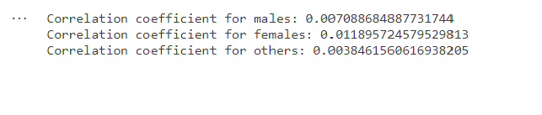
Calculating Pearson Correlation Coefficient between Age groups and Quantity segmented by Customer Genders – This helps in Feature Selection
In this case, there is a weak correlation between Age and Quantity between Customer Gender Type
Hence, we can rule out Age as a feature for predicting quantity
The correlation coefficient indicates the strength and direction of the linear relationship between 'Age' and 'Quantity' for males and females separately.
If the correlation coefficient is close to 1 or -1, it suggests a strong positive or negative linear relationship, respectively. A coefficient close to 0 indicates a weak or no relationship

Slide 11
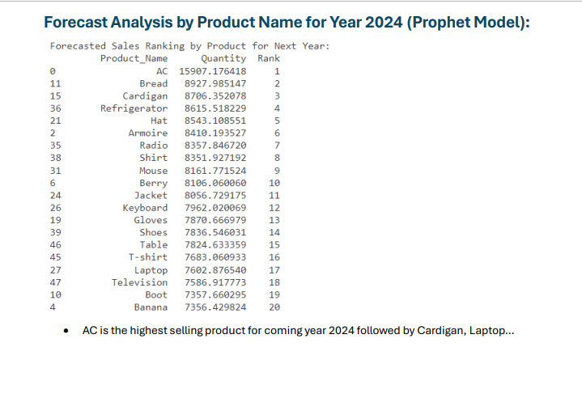
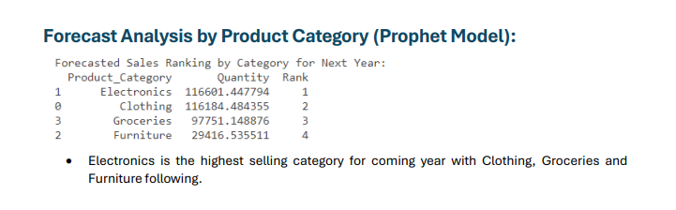
Forecast Analysis on Product Category and Products for 2024 using Prophet Model in Python
This Prediction is based on Quantity and as we can see.
Electronics will maintain its top position even in 2024
Whereas AC is estimated to be the Top selling product in 2024

Slide 12
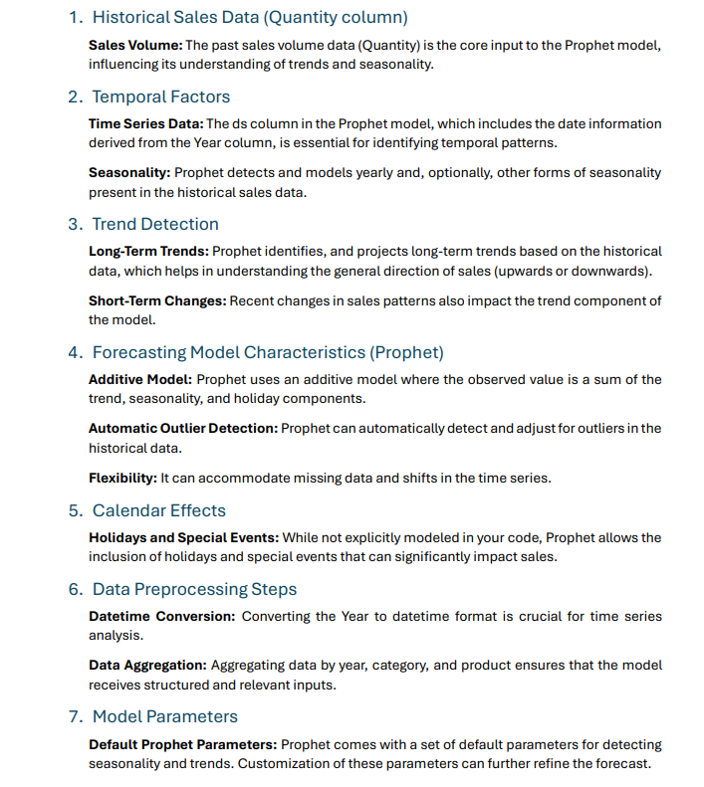
Factors Affecting Data Model (Python Prophet Library Used)

Slide 13
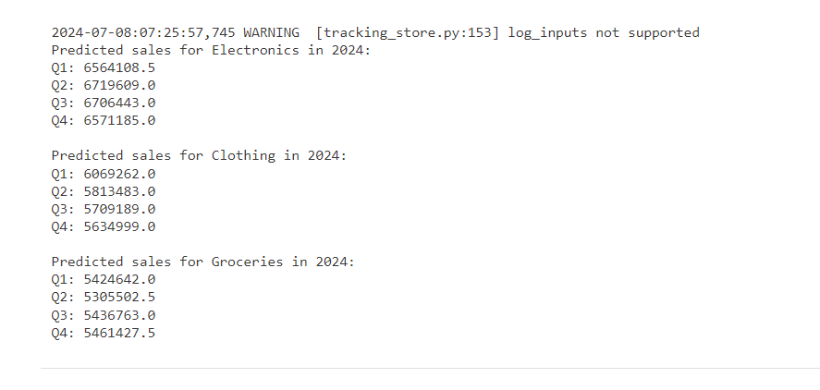
Further Forecasting
Total Sales Amount using machine learning (specifically XGBoost regression) across the top 3 product categories for each quarter in the year 2024, based on historical data from 2021 to 2023.

Slide 14
Thank you

